Slide 1
August 18, 2021
Presented by:
Filiz Zeybek &
Deniz Ismailoff
Notes:
Hello everyone! We are talking about SEL and Mindfulness in education during & post Covid-19 today.

Slide 2
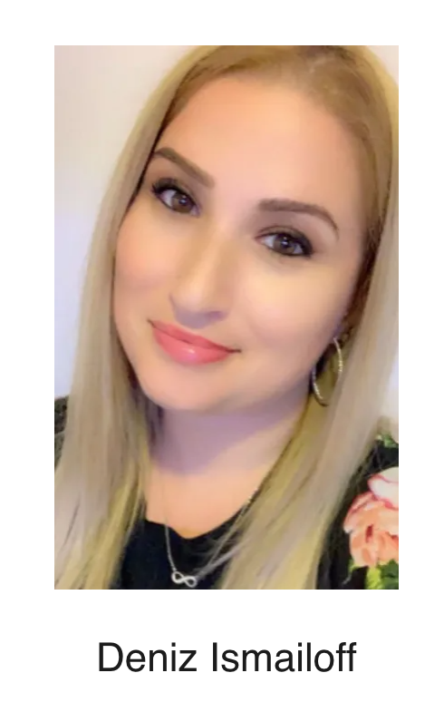
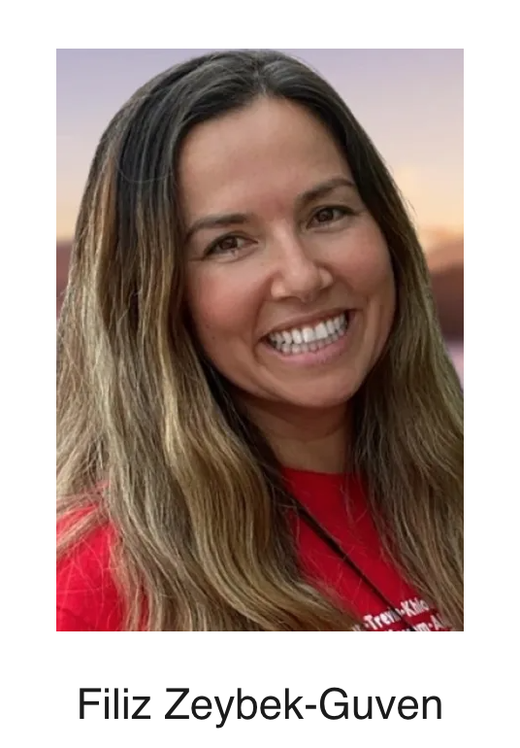
Special Education Teacher in an Inclusion Classroom in Teaneck, New Jersey
Middle School Administrator
in Passaic, New Jersey

Slide 3
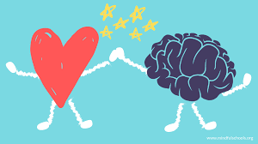
Agenda
1. What is mindfulness? Why is it important?
2. What is SEL? Why does it belong in the classroom?
3. Growth mindset and well-being
4. Activities and Resources
5. Q & A
HouseKeeping
YES – chat is open for your thoughts, feedback, questions and contributions

Slide 4
Working Norms
• Be fully present
• Be respectful – “One mic” – one voice; it’s okay to disagree
• Be candid – speak our truth; use “I” messages
• Be mindful of impact
• Be comfortable
• Be safe

Slide 5
Which Emoji Best Describes You How You Feel Now?
1
2
3
4
5
Notes:
1st Activity: Ask participant to write in chat “ Which emoji best describes you how you feel now?” Then share the outcome. While waiting them to put their response Filiz will talk about how she and her coworker implement this strategy into their lesson during distance learning and how their first grade students and their parents got benefit from it.

Slide 6
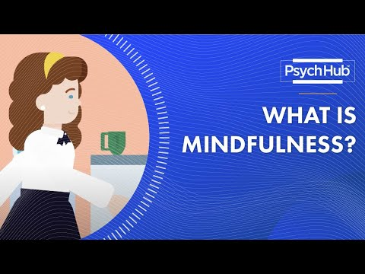
What is Mindfulness?
Mindfulness is a type of reflection in which you focus on being conscious of what you are feeling in the moment, without judgment
Observing what is coming at you from the outside world and how you internalize this information
No judgement-being reflective
Fully conscious-responding wisely
22 Mindfulness Exercises & Activities For Adults

Slide 7
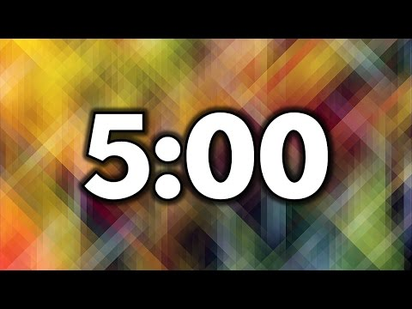
Let’s Practice!
-Choose 1 adult mindfulness activity with your group
-Practice mindfulness exercise together
-1 person from your group share:
Answer: Which activity and 1 take away
22 Mindfulness Exercises & Activities For Adults

Slide 8
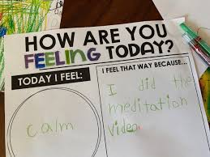
j
Mindfulness in the Classroom
Improves memory, organizational skills, reading and math scores, all while giving kids the tools they need to handle toxic stress.
KIDS
Mindfulness Can:
Mitigate the effects of bullying
Enhance focus in children with ADHD
Reduce attention problems
Improve mental health and wellbeing
Improve social skills when well taught and practiced with children and adolescents

Slide 9
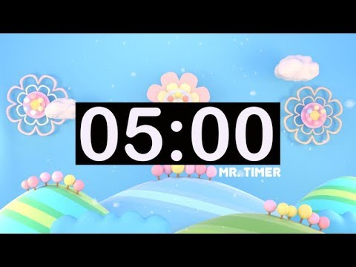
Activity Time!
-Choose 1 student mindfulness activity with your group
-Practice mindfulness exercise together
-1 person from your group share:
Answer: Which activity ? How would you
incorporate this activity in your classroom?
25 Fun Mindfulness Activities for Children and Teens
Breathing for Mindfulness

Slide 10
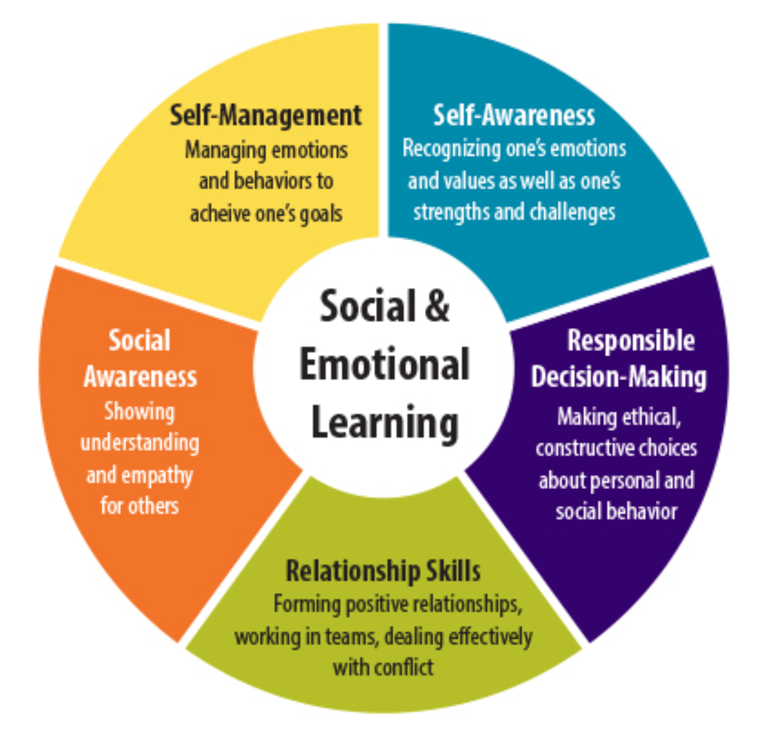
Social and Emotional Learning (SEL)
5 Competencies
The Collaborative for Academic, Social, and Emotional Learning (CASEL)
"Social and emotional learning (SEL) is the process through which children and adults acquire and effectively apply the knowledge, attitudes, and skills necessary to understand and manage emotions, set and achieve positive goals, feel and show empathy for others, establish and maintain positive relationships, and make responsible decisions.”
Notes:
School, whether it’s done online, in person, or a mix of the two, can give students a sense of normalcy. But it’s important to acknowledge the anxiety students might be feeling. Chronic stress and trauma can interrupt the learning process. You can help by incorporating social-emotional learning (SEL) in your teaching. SEL can help students learn better.

Slide 11
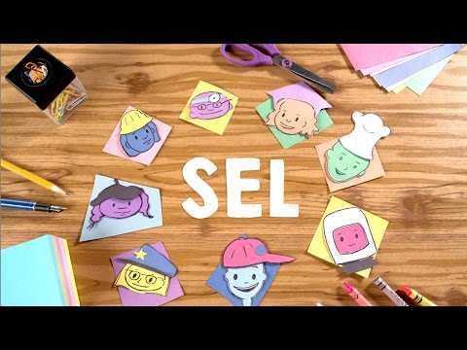
Social and Emotional Learning (SEL)
5 Easy Social Emotional Learning Activities for Kids to do at Home
37 Social-Emotional Learning Activities and Games for Teachers and Students
Are you socially and emotionally
aware of your own emotions? actions?

Slide 12
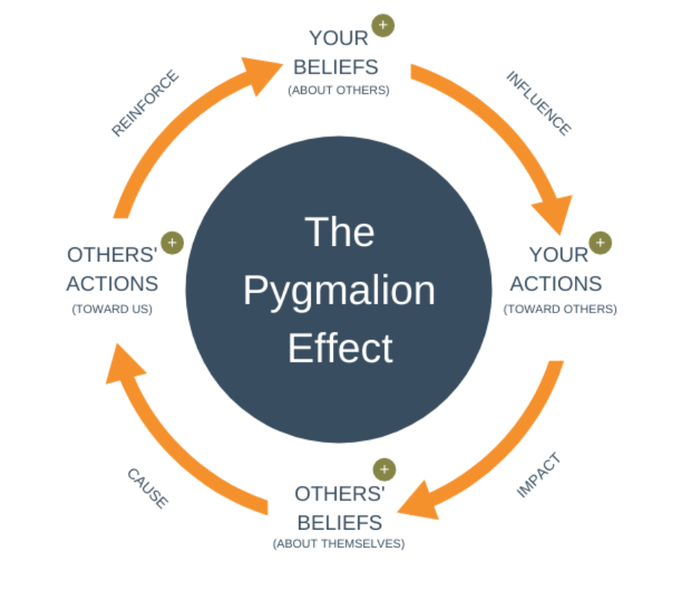
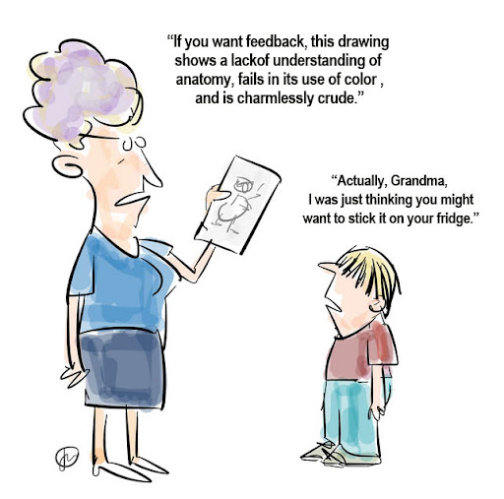
Pygmalion Effect

Slide 13
MINDFULNESS BEGINS WITH YOU
“When we strive to be self-aware and responsible and to practice self-control, when we value building and maintaining relationships with others, when we accept others without intentional bias or judgment, and when we take care of our own social and emotional wellbeing, our students will be more inclined to listen, learn, and emulate these actions.”

Slide 14
Thank You!

