Slide 1
Presentation By: Filiz Zeybek-Guven and Deniz Ismailoff
Ethics Project
Responsible, Ethical, and Legal
Technology Guidelines
Browser

Slide 2
Student
Confidentiality
Online
Ethics
What You Will Learn
Rights
and
Properties
Quiz
References
Social
Media

Slide 3
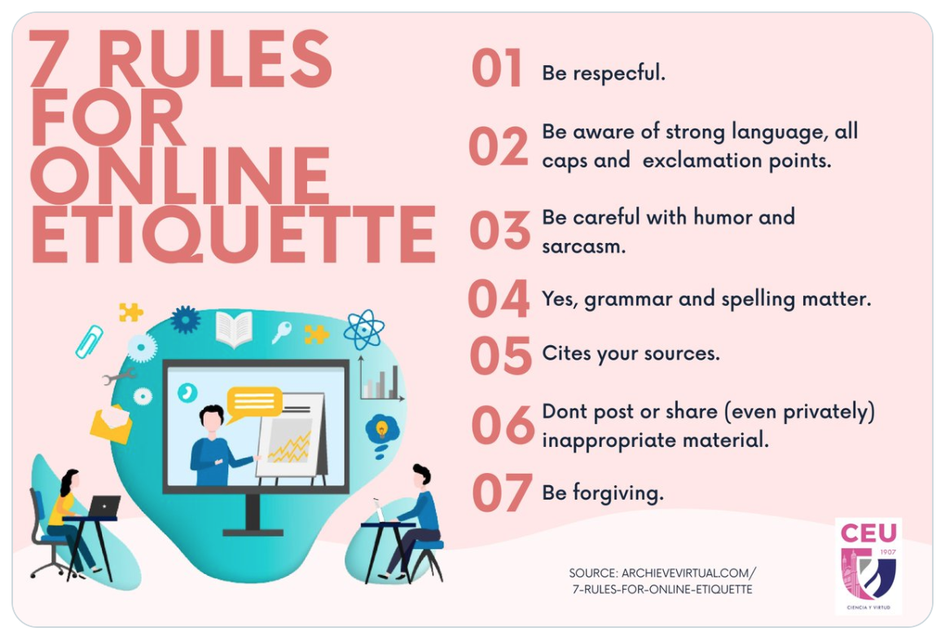
What is Online Etiquette?
Internet
Gatherings
Depending on your audience and how you are communicating, there are different rules to be followed.
Online etiquette is the right or acceptable way of communicating on the internet.
(Online Etiquette, 2017)

Slide 4
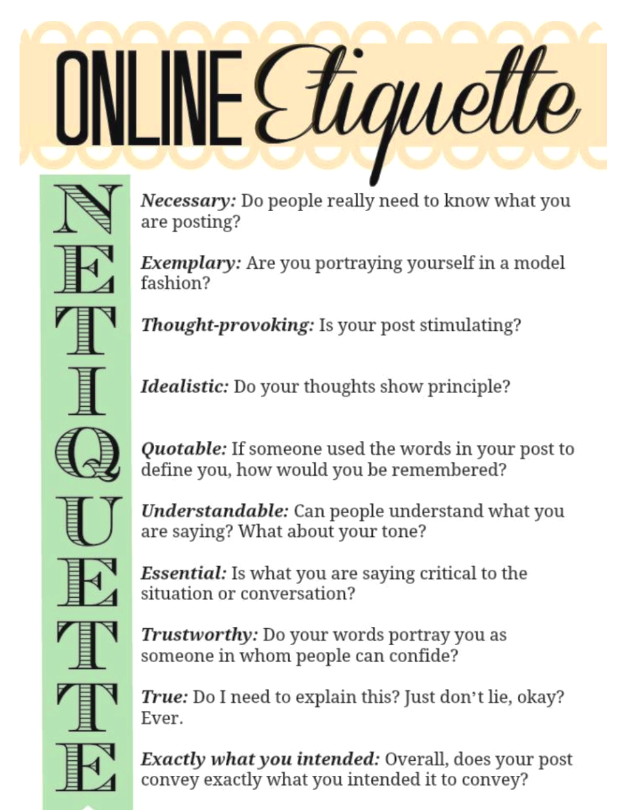
Online Etiquette
(Online Etiquette, n.d.)

Slide 5
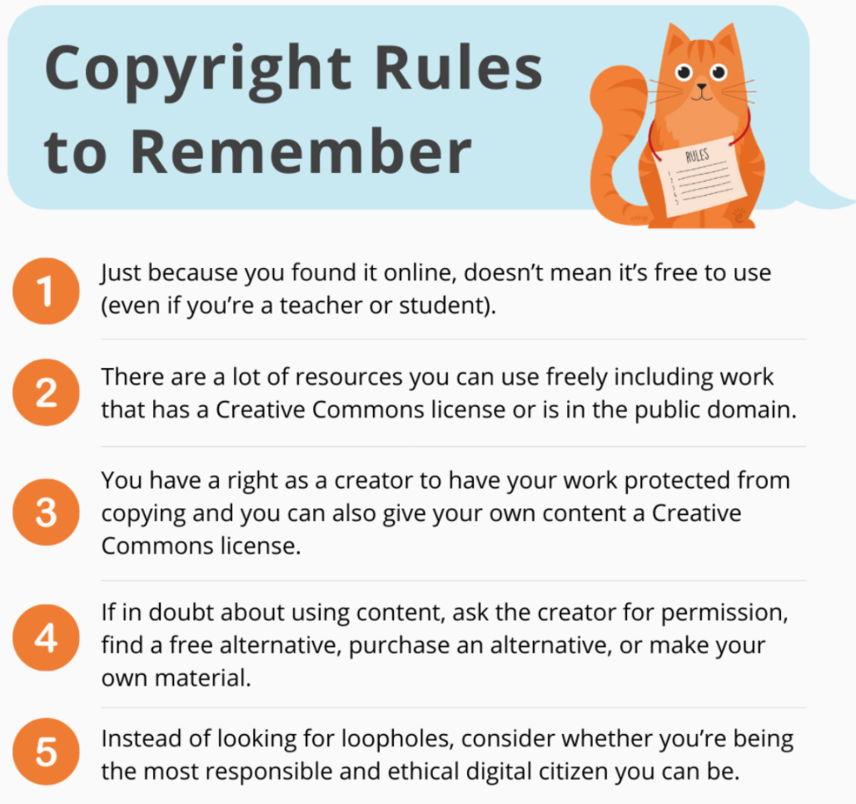
Intellectual
Rights and Properties
The Educator’s Guide to Copyright and Creative Commons
Following Copyrights
Copyright rules are essential to those who create original work. It protects their creations from being utilized without permission. These rules have been set in place by the U.S. the constitution.
(The Educator’s Guide to Copyright, n.d.)
Copyright and Creative Commons are Friends
Copyright law gives creators certain kinds of control over their creative work. Creative Commons works within copyright laws. It allows creators to grant permission for anyone to utilize their work globally.
(Copyright and Creative Commons are Friends, 2017)
(The Educator’s Guide to Copyright, n.d.)
M

Slide 6
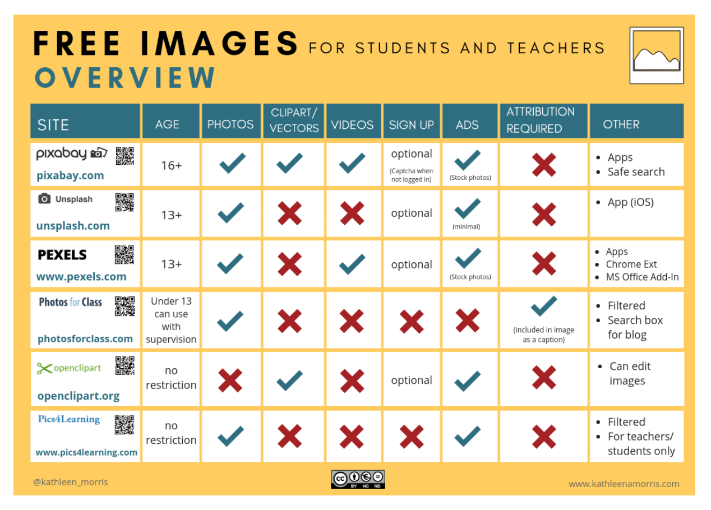
Free Images for
Students and Teachers
Summary Poster
to Utilize in Your
Lessons/Teaching
(The Educator’s Guide to Copyright, n.d.)

Slide 7
Social Media
Usage
Social media usage is one of the most popular online activities. In 2020, over 3.6 billion people were utilizing social media worldwide, which projected to increase to approximately 4.41 billion in 2025.
(Number of Social Media Users, 2021)
(Social Media Tips for Teachers, 2018)

Slide 8
8 Social Media Tips for Teachers
Lesson #1: Social media is not PRIVATE
Lesson #2: Be mindful of your social media posts
Lesson #3: Ensure your photos are appropriate
Lesson #4: Oversharing of personal data
Lesson #5: Turn off Geotagging on your phone
Lesson #6: Do Not friend or follow students
Lesson #7: Do Not friend parents on social media
Lesson #8: Maintain professionalism at all times
(Social Media Tips for Teachers, 2018)

Slide 9
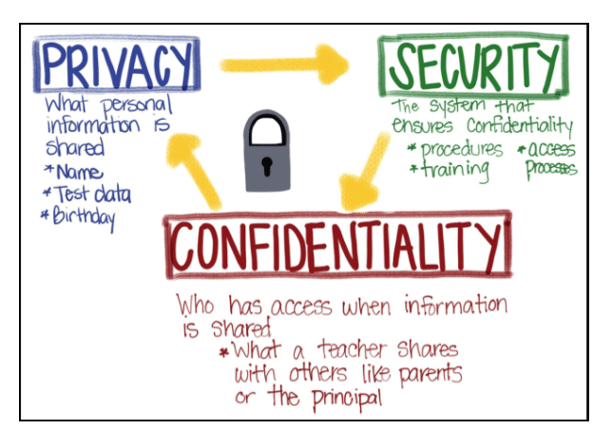
Student Confidentiality
Student data privacy and security are essential, and understanding the difference between privacy, confidentiality, and security is critical for teachers.
Teachers are responsible for maintaining each of these components.
(Reddy, 2019)
(Reddy, 2019)

Slide 10
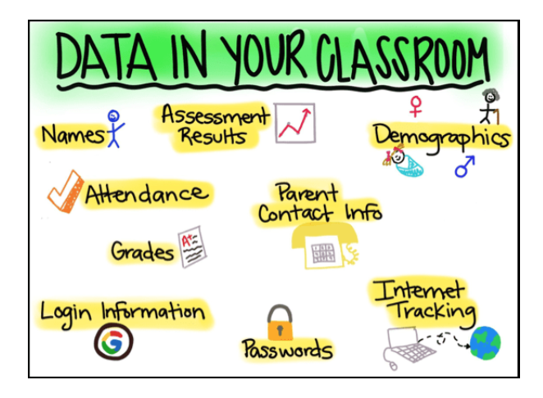
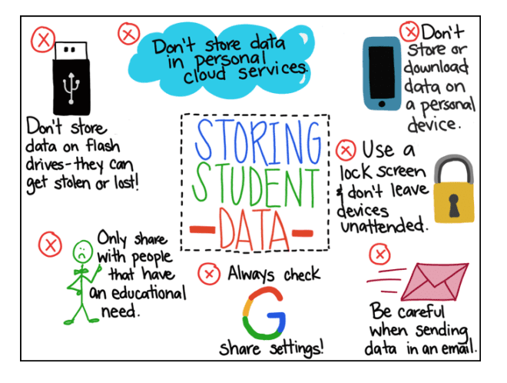
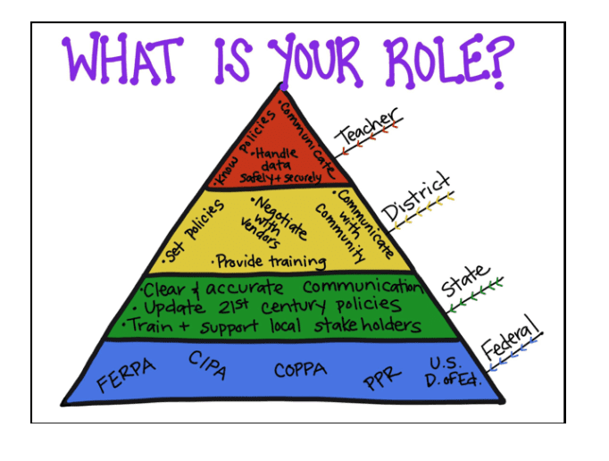
Classroom Confidentiality
(Reddy, 2019)
12:01 PM

Slide 11
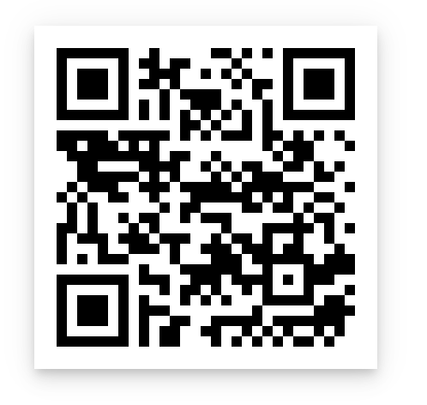
Quiz
Now it is your turn!
Please scan the QR code and take the quiz.
If you score 80% or above, you pass!
Good luck!

Slide 12
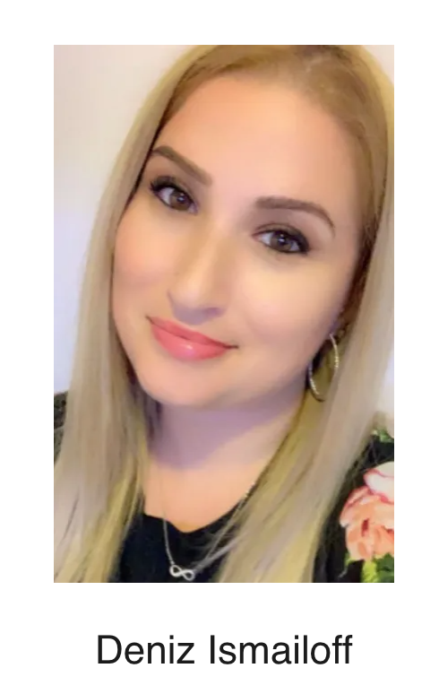
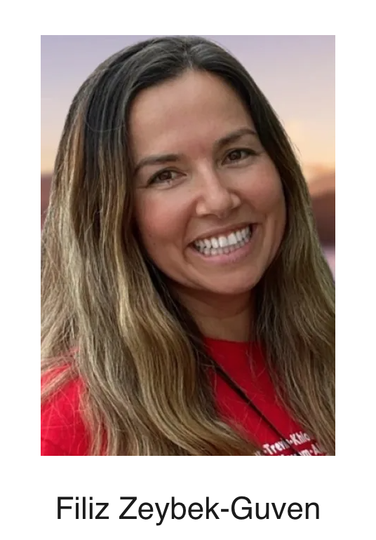
Thank You

Slide 13
References
Copyright and Creative Commons are friends. (2017). Creative Commons. https://creativecommons.org/get-cc-savvy/copyright-creativecommons-are-friends.
The educator’s guide to copyright, fair use, and Creative Commons. (n.d.). The Edublogger. https://www.theedublogger.com/copyright-fair-use-and-creative-commons/#What-Is-Copyright?
Number of social media users 2025. (2021). Statista. https://www.statista.com/statistics/278414/number-of-worldwide-social-network-users.
Online etiquette by @Sarah Marie! | Online etiquette, business etiquette, netiquette. (n.d.). Pinterest. https://www.pinterest.com/pin/516577019729317538.
Online etiquette: Definition, tips, examples and importance. (2017). TechWelkin. https://techwelkin.com/online-etiquette-definition-tips-examples-importance.
Reddy, A. (2019). The educator's role: Privacy, confidentiality, and security in the classroom. Student Privacy Compass. https://studentprivacycompass.org/scheid1.
Social media tips for teachers. (2018). 2 Peas and a Dog. https://www.2peasandadog.com/2015/05/social-media-tips-for-teachers.html.
WTO | intellectual property (TRIPS) - what are intellectual property rights? (n.d.). World Trade Organization - Global trade. https://www.wto.org/english/tratop_e/trips_e/intel1_e.htm.

